Slide 1


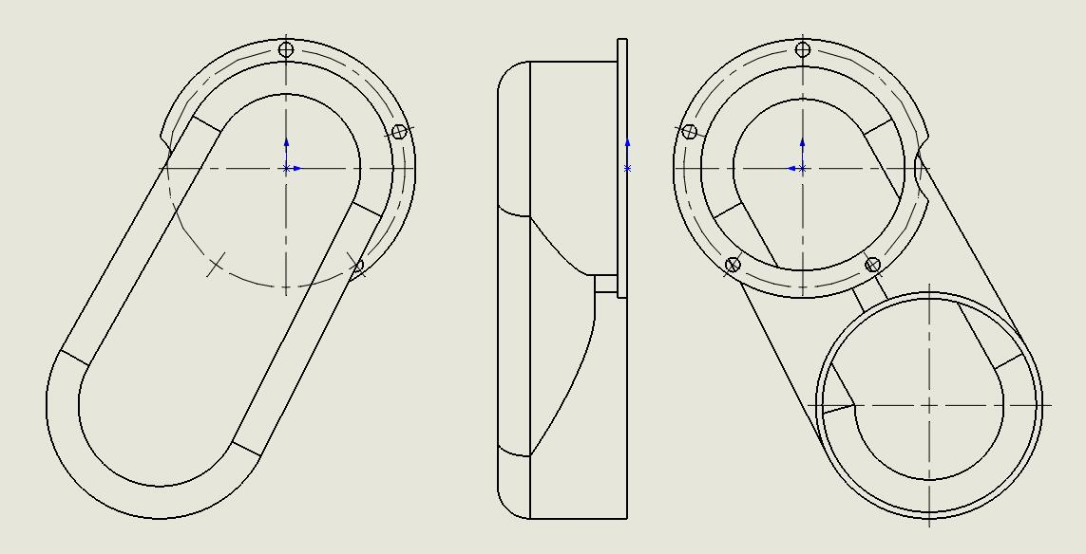
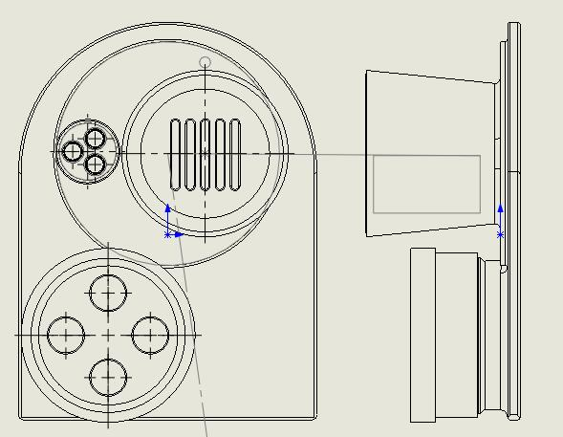
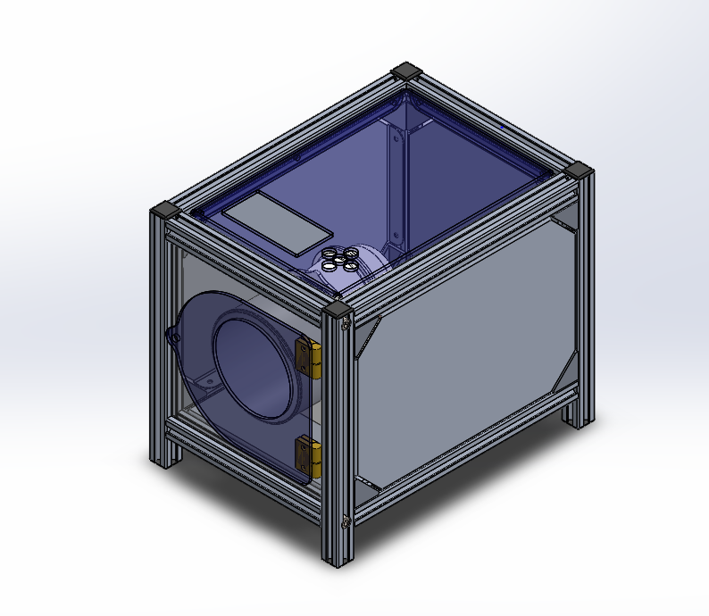
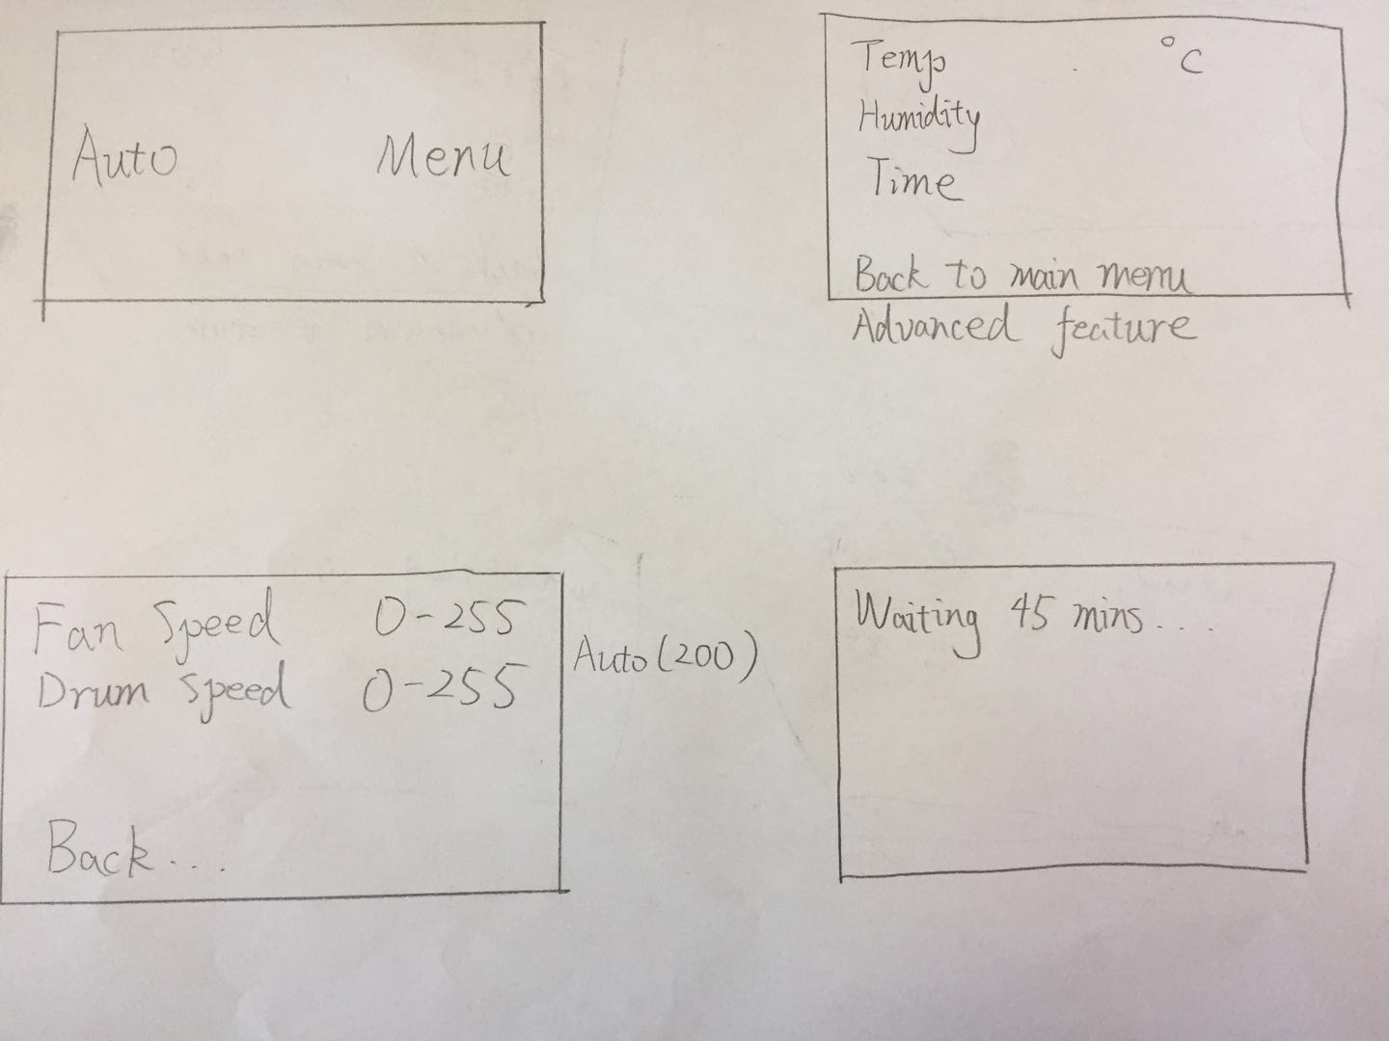
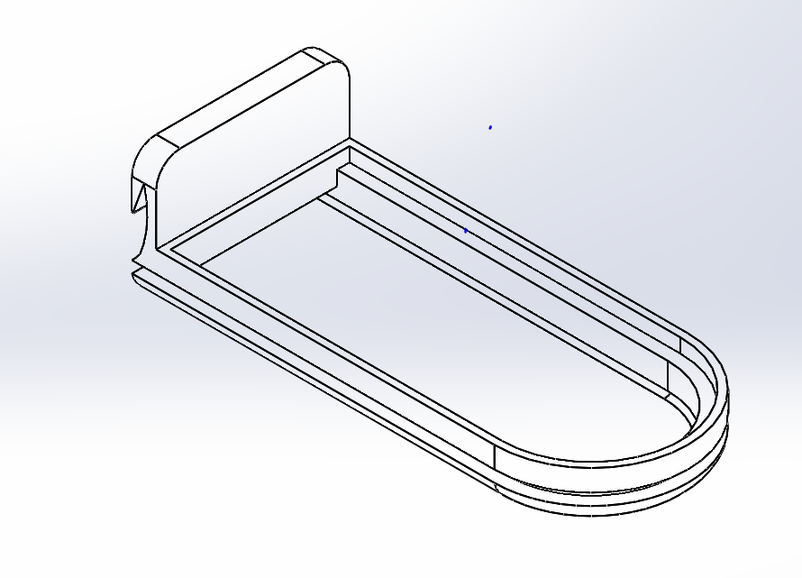
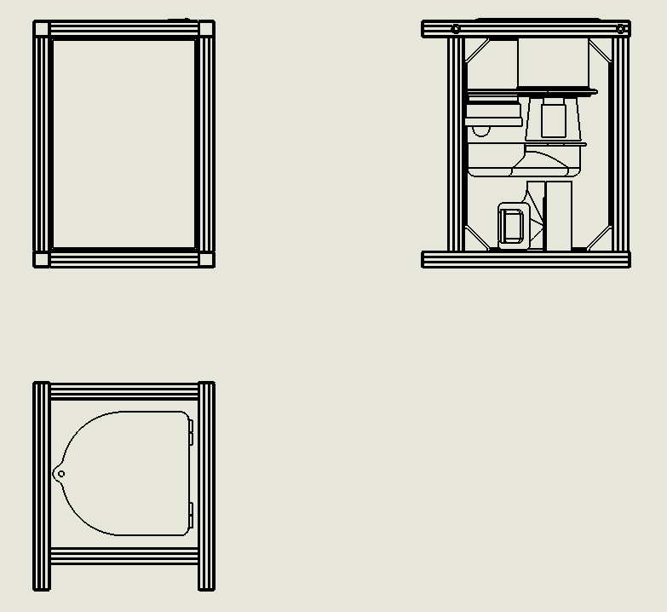
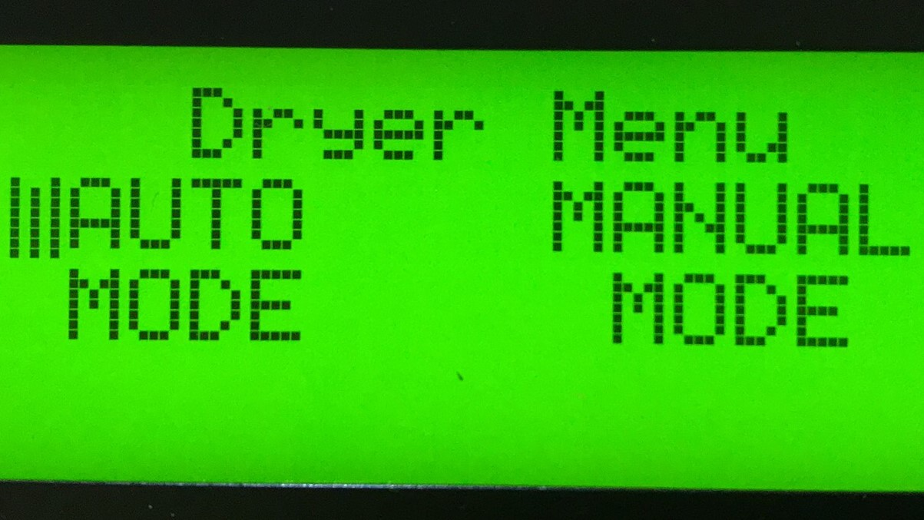
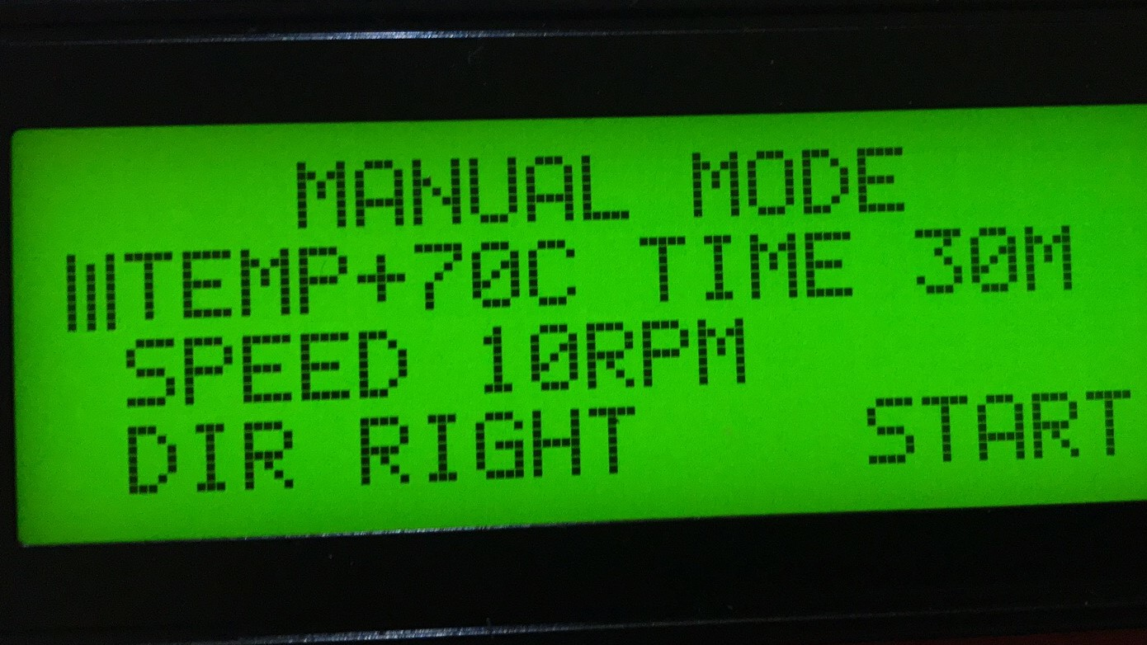
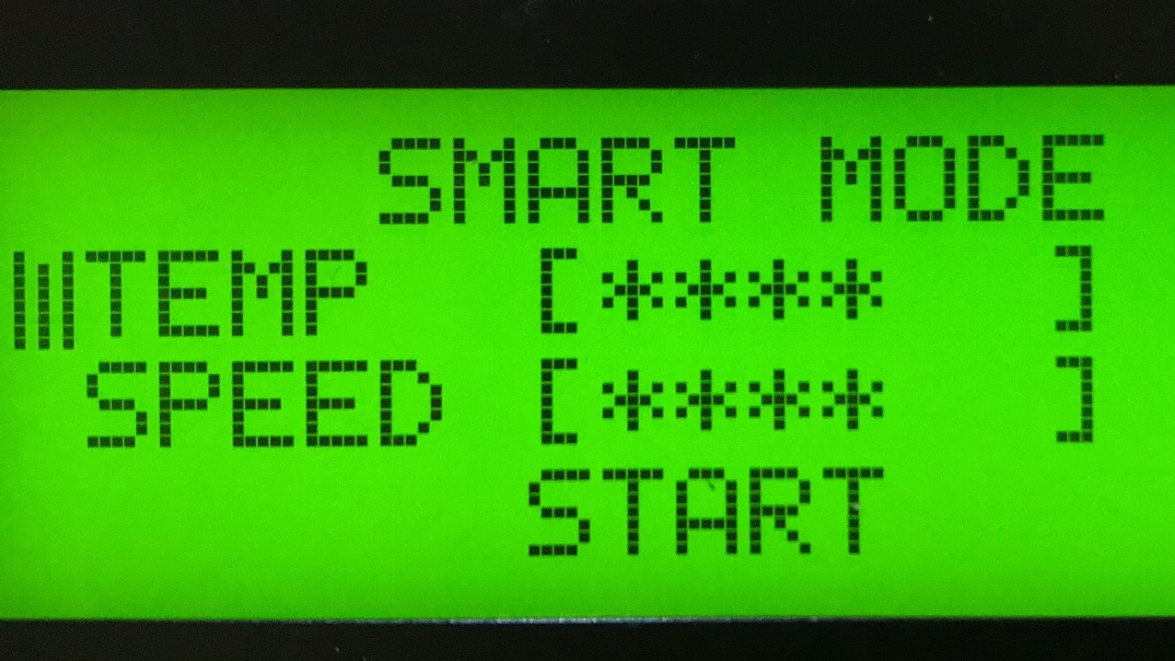

Energy Recovery Clothes Dryer with Easy Operation
VANT 151 Project
Leo Sun(Team Captain), Oliver Qiu, Bruce Bian, Barry Xu, Kyle Lin and Jason Yin
Team 6
Introduction
The dryer uses a fan and an electric heater to heat clothes. Dryers are common in almost every western household. The dryer accounts for about 6% of household energy consumption. The average water to vapour conversion efficiency for conventional dryer is only 50%-70%. This can be account to the lack to circulation system. One of the plan is to build a system with the ability to automatically adjust temperature and time using micro-computer. Increasing the efficiency of clothes dryer demonstrates the engineer’s responsibility on environment.
The second (Figs. 2d) concept for the user interface is shown as the figure. There are two selectable choices, “Auto” and “Menu”. Once choosing the “Auto”, the system would be automatically initiated. Once choosing “Menu” to access the menu interface, the three adjustable factors, temperature(50 in “Auto” mode), humidity (10 in “Auto” mode) and time (45 in “Auto” mode), would be displayed. Also, another selection, “Advanced feature” (this would be “Back to main menu” in “Auto” mode), would be displayed below the others for accessing the further interface. Then, users can adjust the fan speed and the drum speed (both are 200 in “Auto” mode). in the last interface, user can see the remaining time of drying.
Conclusions
With the two months hard work, all members in group 6 did the contribution to this project. When we are doing the project, there are some problems in the coding parts and assembly parts. We did some changes of the original design of the assembly prats. For the coding part, it still has some problems, and the group members who are in charge of this part will try their best to solve it before July 17. On the other hand, we did a good jog in aspect of bread board prototype, 3D design and 3D printing and final assembly. All in all, this is a good experience for all of the group members to woke as a team.
Fig. 4. The drawing of the U turn.
Fig. 1. The current cloth dryer use technology like electronic control center, which can collect the instructions from the users through the buttons. Based on the instruction from the users, the cloth dryer will work automatically.
Fig. 5. The drawing for the Air Duct
Literature cited
ENERGY STAR. (2011). Residential Clothes Dryers. Retrieved from https://www.energy star.gov/ sites/ default/files/asset/document /ENERGY_STAR_Scoping_Report_Residential_Clothes_Dryers.pdf
Requirements
Build a scaled-down prototype of a heat recovery clothes dryer.
Size not exceeding 250 x 220 x 300 mm (fit within carton for copier paper).
At least 0.5 L capacity, able to dry a cotton
handkerchief (size to be decided later) within 1 hour.
Maximum allowable electrical power consumption: 24 VAC, 40 VA.
Alphanumeric LCD display and 5-button navigation pad for user interface.
Auto and manual operating modes.
For manual mode, able to set desired drying time, temperature and dryness.
Fig. 2 (d). The Sketch of the second concept for the user interface
Fig. 6. The design of the water tray
Final Design
The overall design for the dryer is generally based on the given sample. Some data, such as the diameter of the copper tubes, sizes of the screws and the volume of the whole dryer, is directly refer to the sample design.
Final Design:
The Dryer:
Length: 300mm
Width: 250mm
Height: 220mm
Final Design of the Components:
Water Tray:
Length: 95mm
Width: 40mm
Air Duct:
Width: 100mm
Height: 160mm
U Turn:
Length: 157.91mm
Width: 70mm
Height: 40mm
Test Results
Auto Mode
humidity: 30%
temperature: 70 degree Celsius
time: 30 minutes
weight for samples: 50g
rotating speed: 10 RPM
power input: 120VAC
inner power: 5VAC
Final Calculated Energy Efficiency: 17.65%
Manual Mode
humidity: 20%
temperature: 65 degree Celsius
time: 30 minutes
weight for sample: 45g
rotating speed 20 RPM
power input: 120VAC
inner power: 5VAC
Final Calculated Energy Efficiency: 18.43%
Acknowledgments
We would like to express sincere thanks to our professor Dr. Ernest Goh. We would also like to express heartfelt thanks to out teaching assistant Delun Chan. Our appreciation also goes out to all those who have helped us at some time or other English instructors who have provided language support to us. Lastly, we would like to thank UBC to afford all the cost of tools and equipment.
Design Alternatives
The first (Fig. 2. a-c) design for the user interface is shown as the figure. After going through the primary page, there are two selectable choices, “AUTO MODE” and “MANUAL MODE”. Once choosing the manual mode, the drum speed, temperature, rotating direction are adjustable for users. Once choosing the “AUTO MODE”, the temperature and the rotating speed are available to adjust.
Fig. 3. The drawing of the dryer
For further information Contact:
Leo Sun
E-mail : leomastersun@gmail.com
Fig. 2 (a-c). The display for the first design of user interface

